Slide 1


12/01/2023
PATENTS:
THE CASE OF IMPOSSIBLE FOODS
Leila Dardouri
Alberto Lazari
Francesco Protopapa
Diego Stafa
Giacomo Stevanato
Light It Up

Slide 2

WE
HAVE
A
PROBLEM

Slide 3
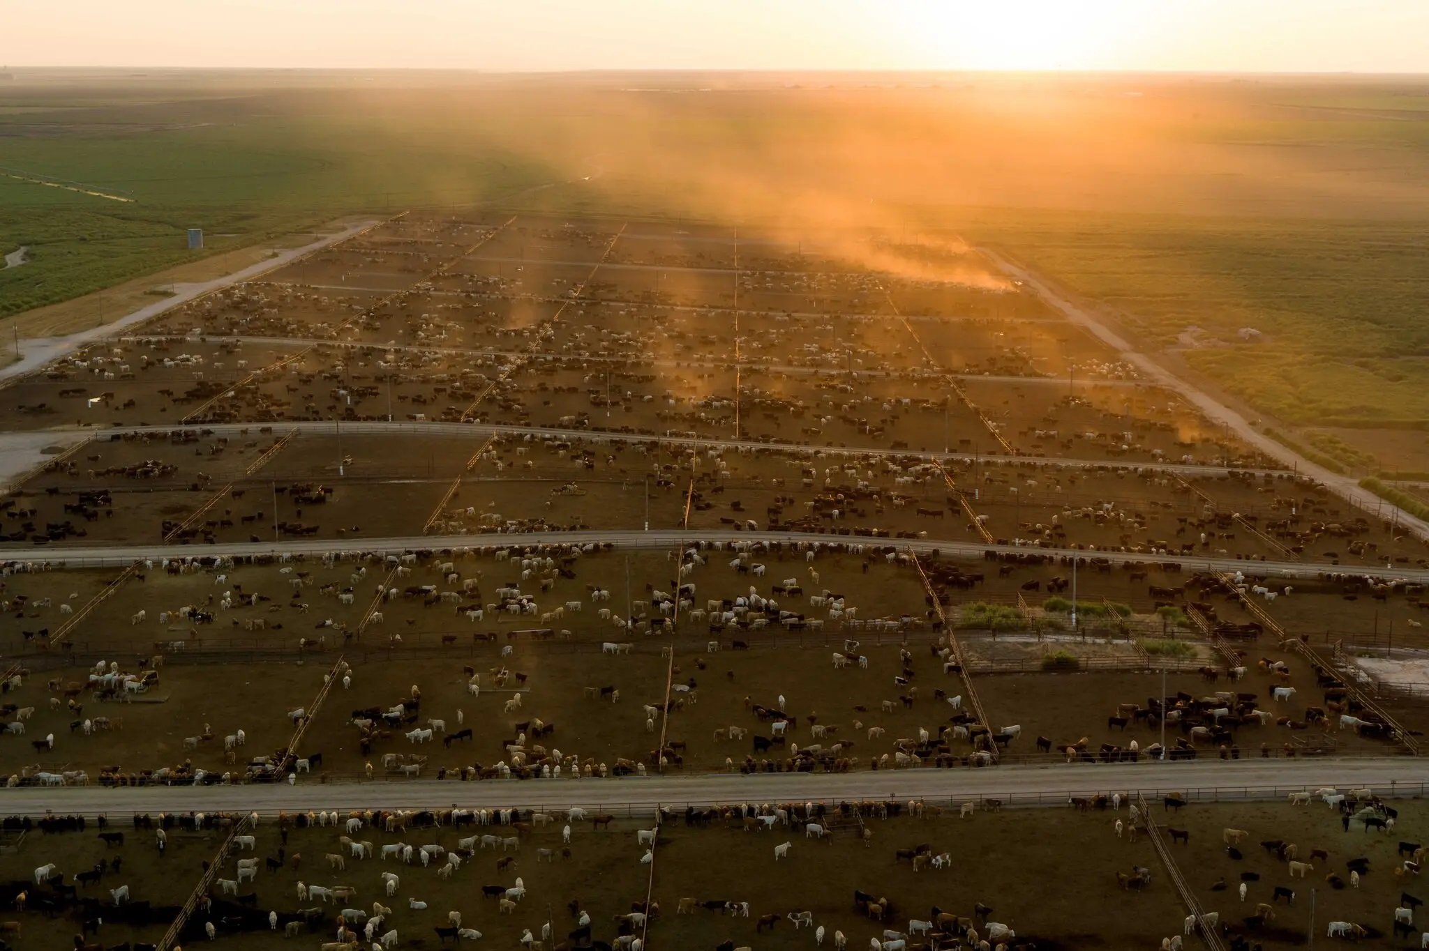
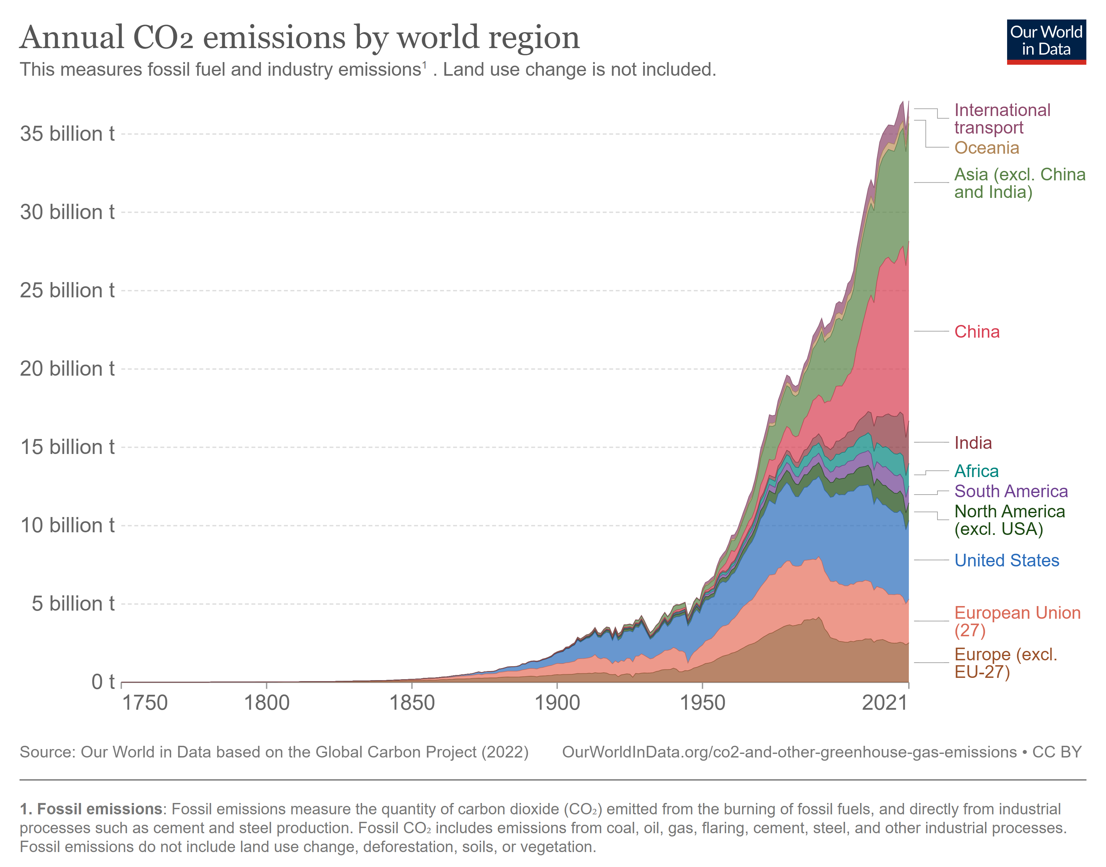

Slide 4
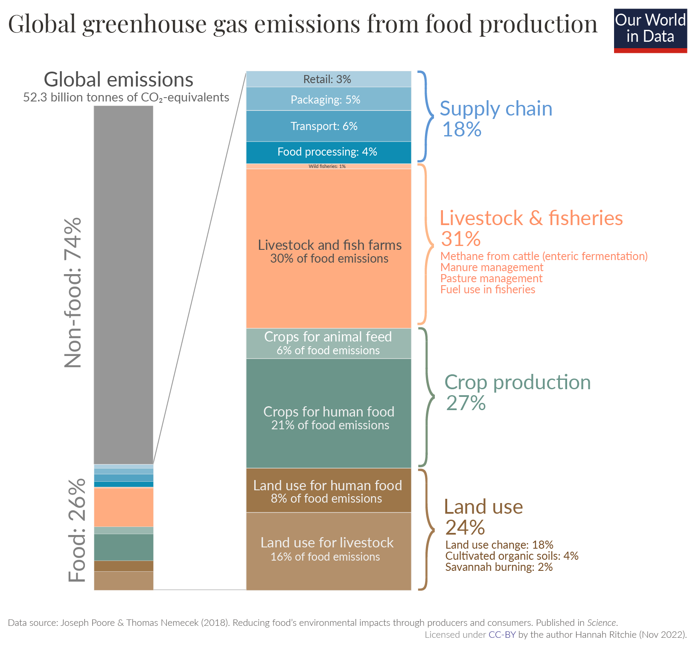

Slide 5
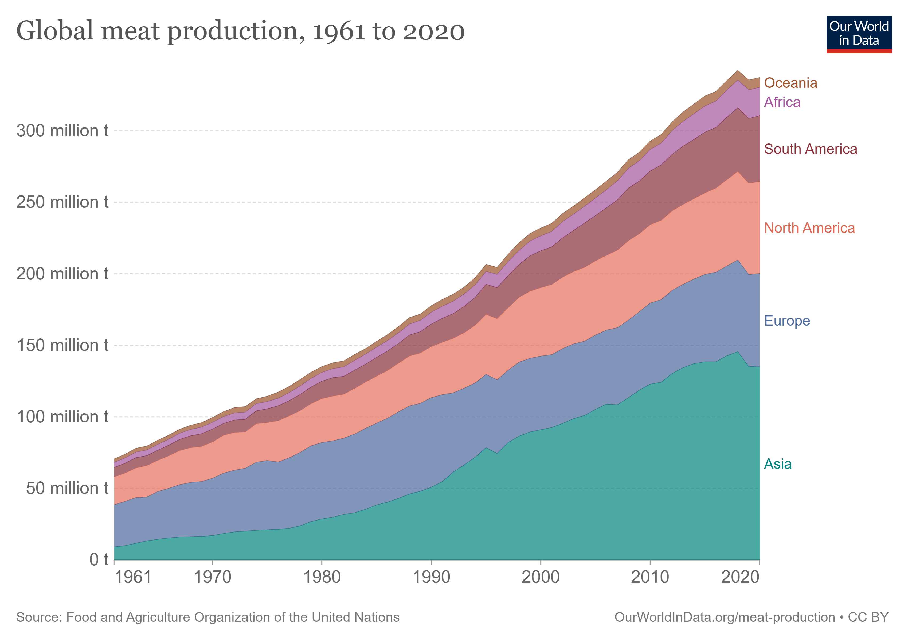

Slide 6
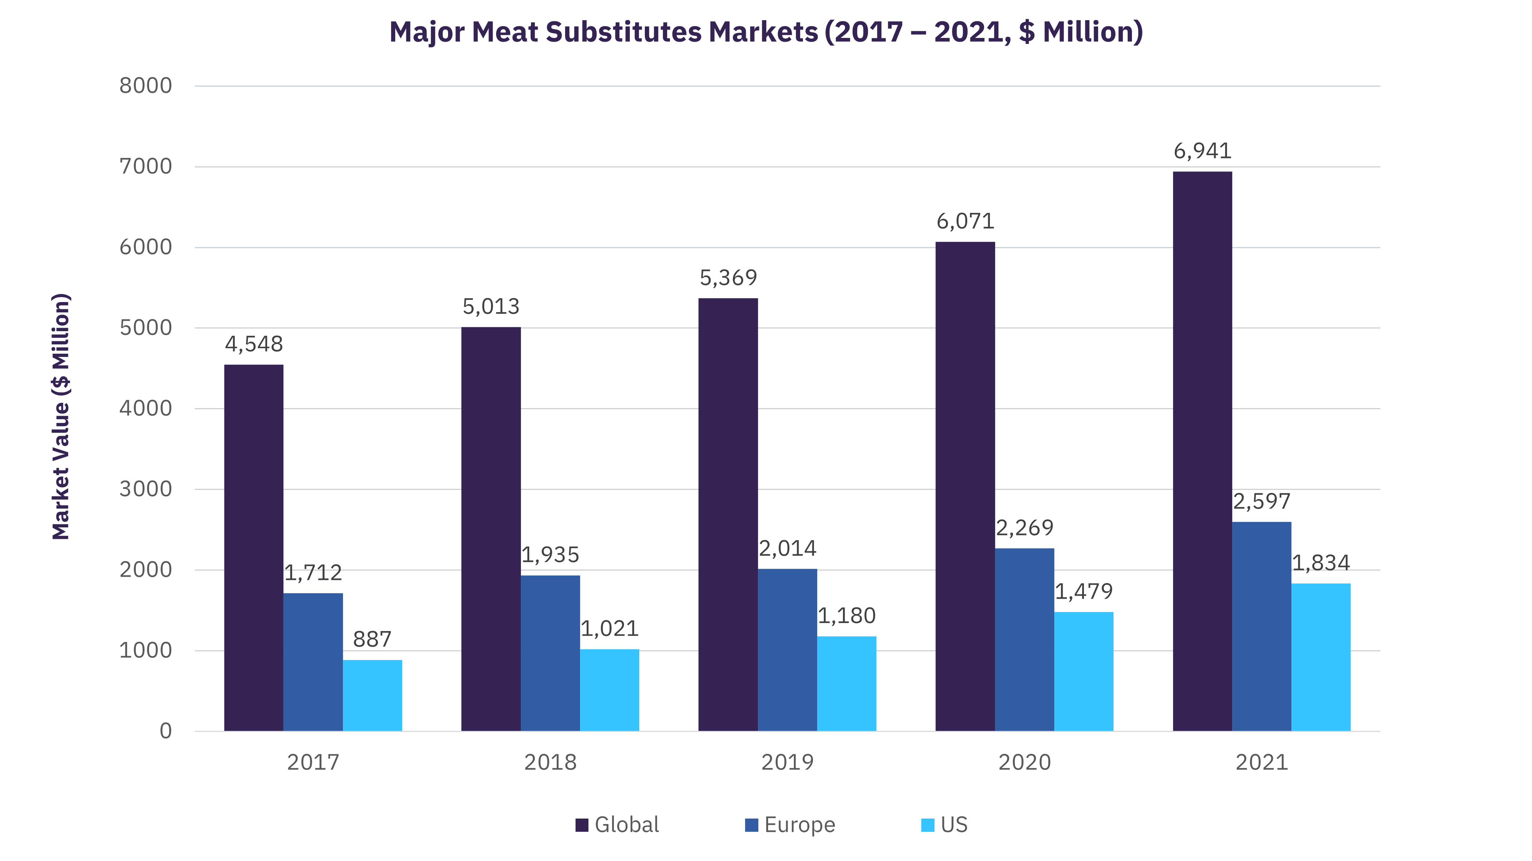
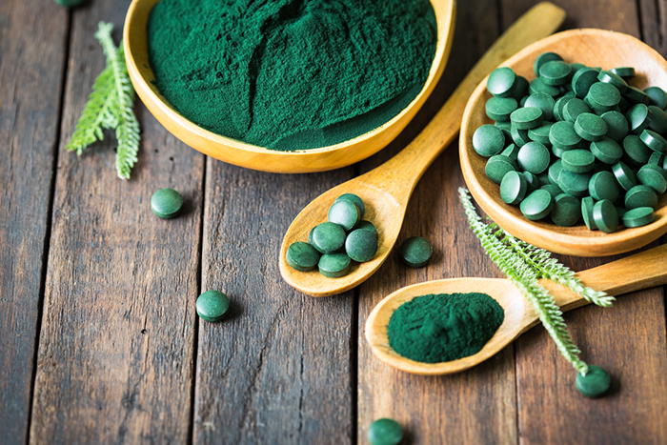
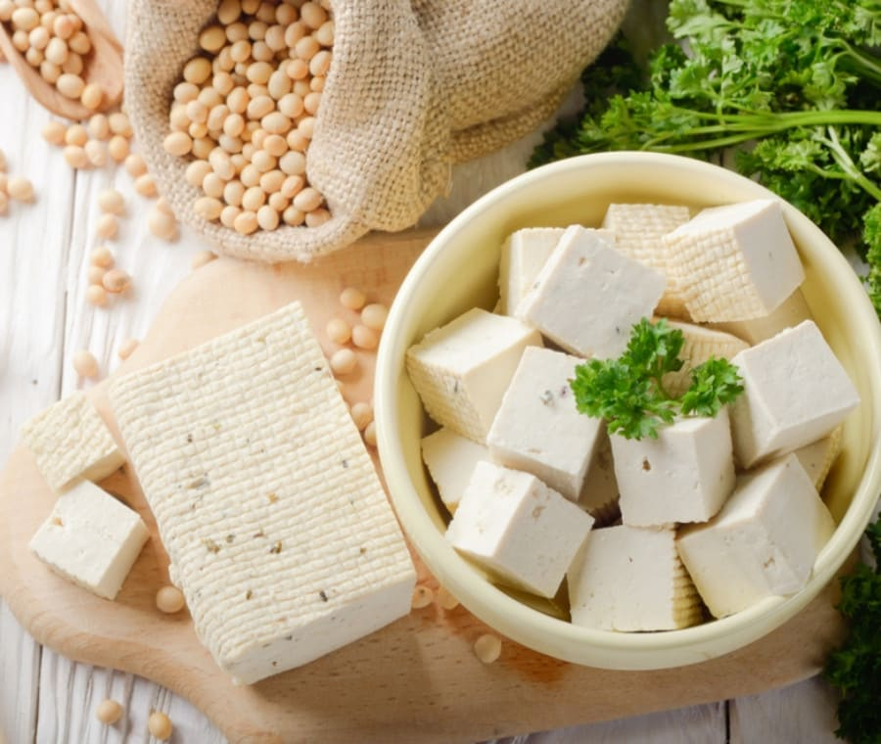
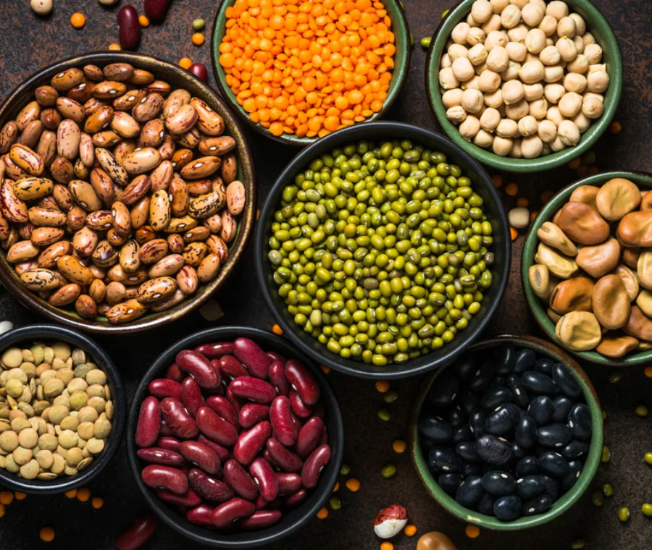
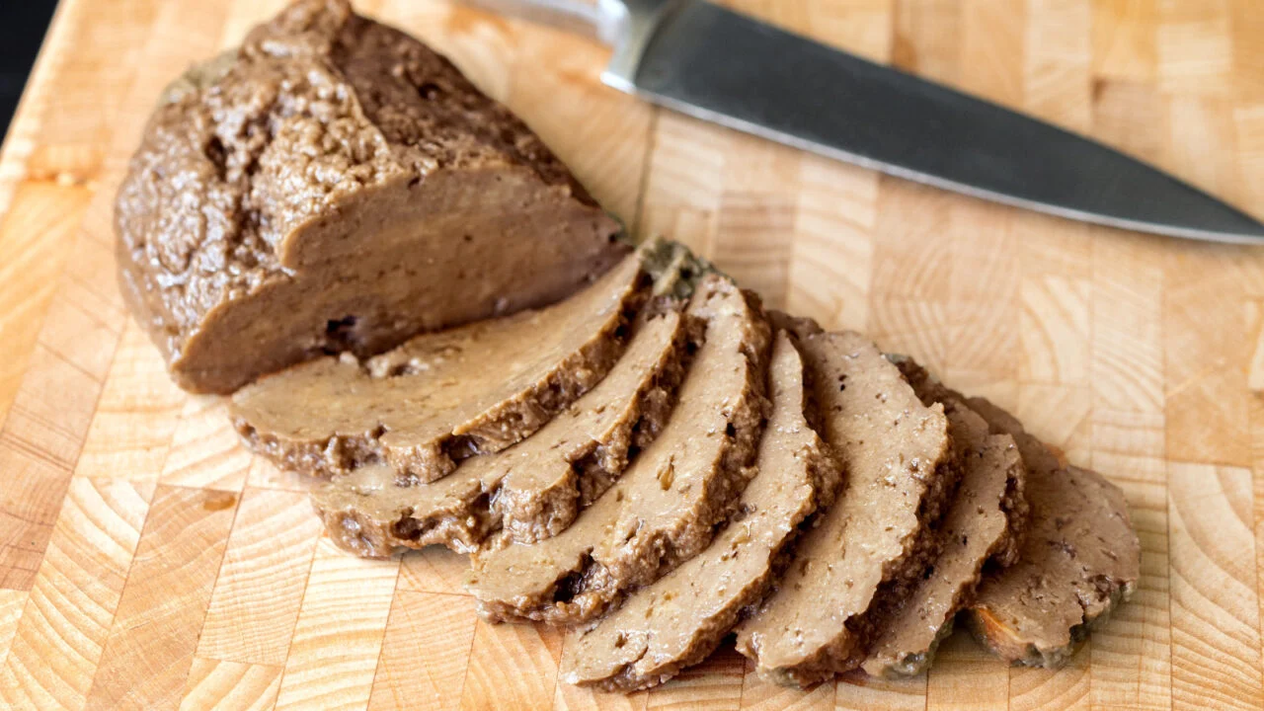
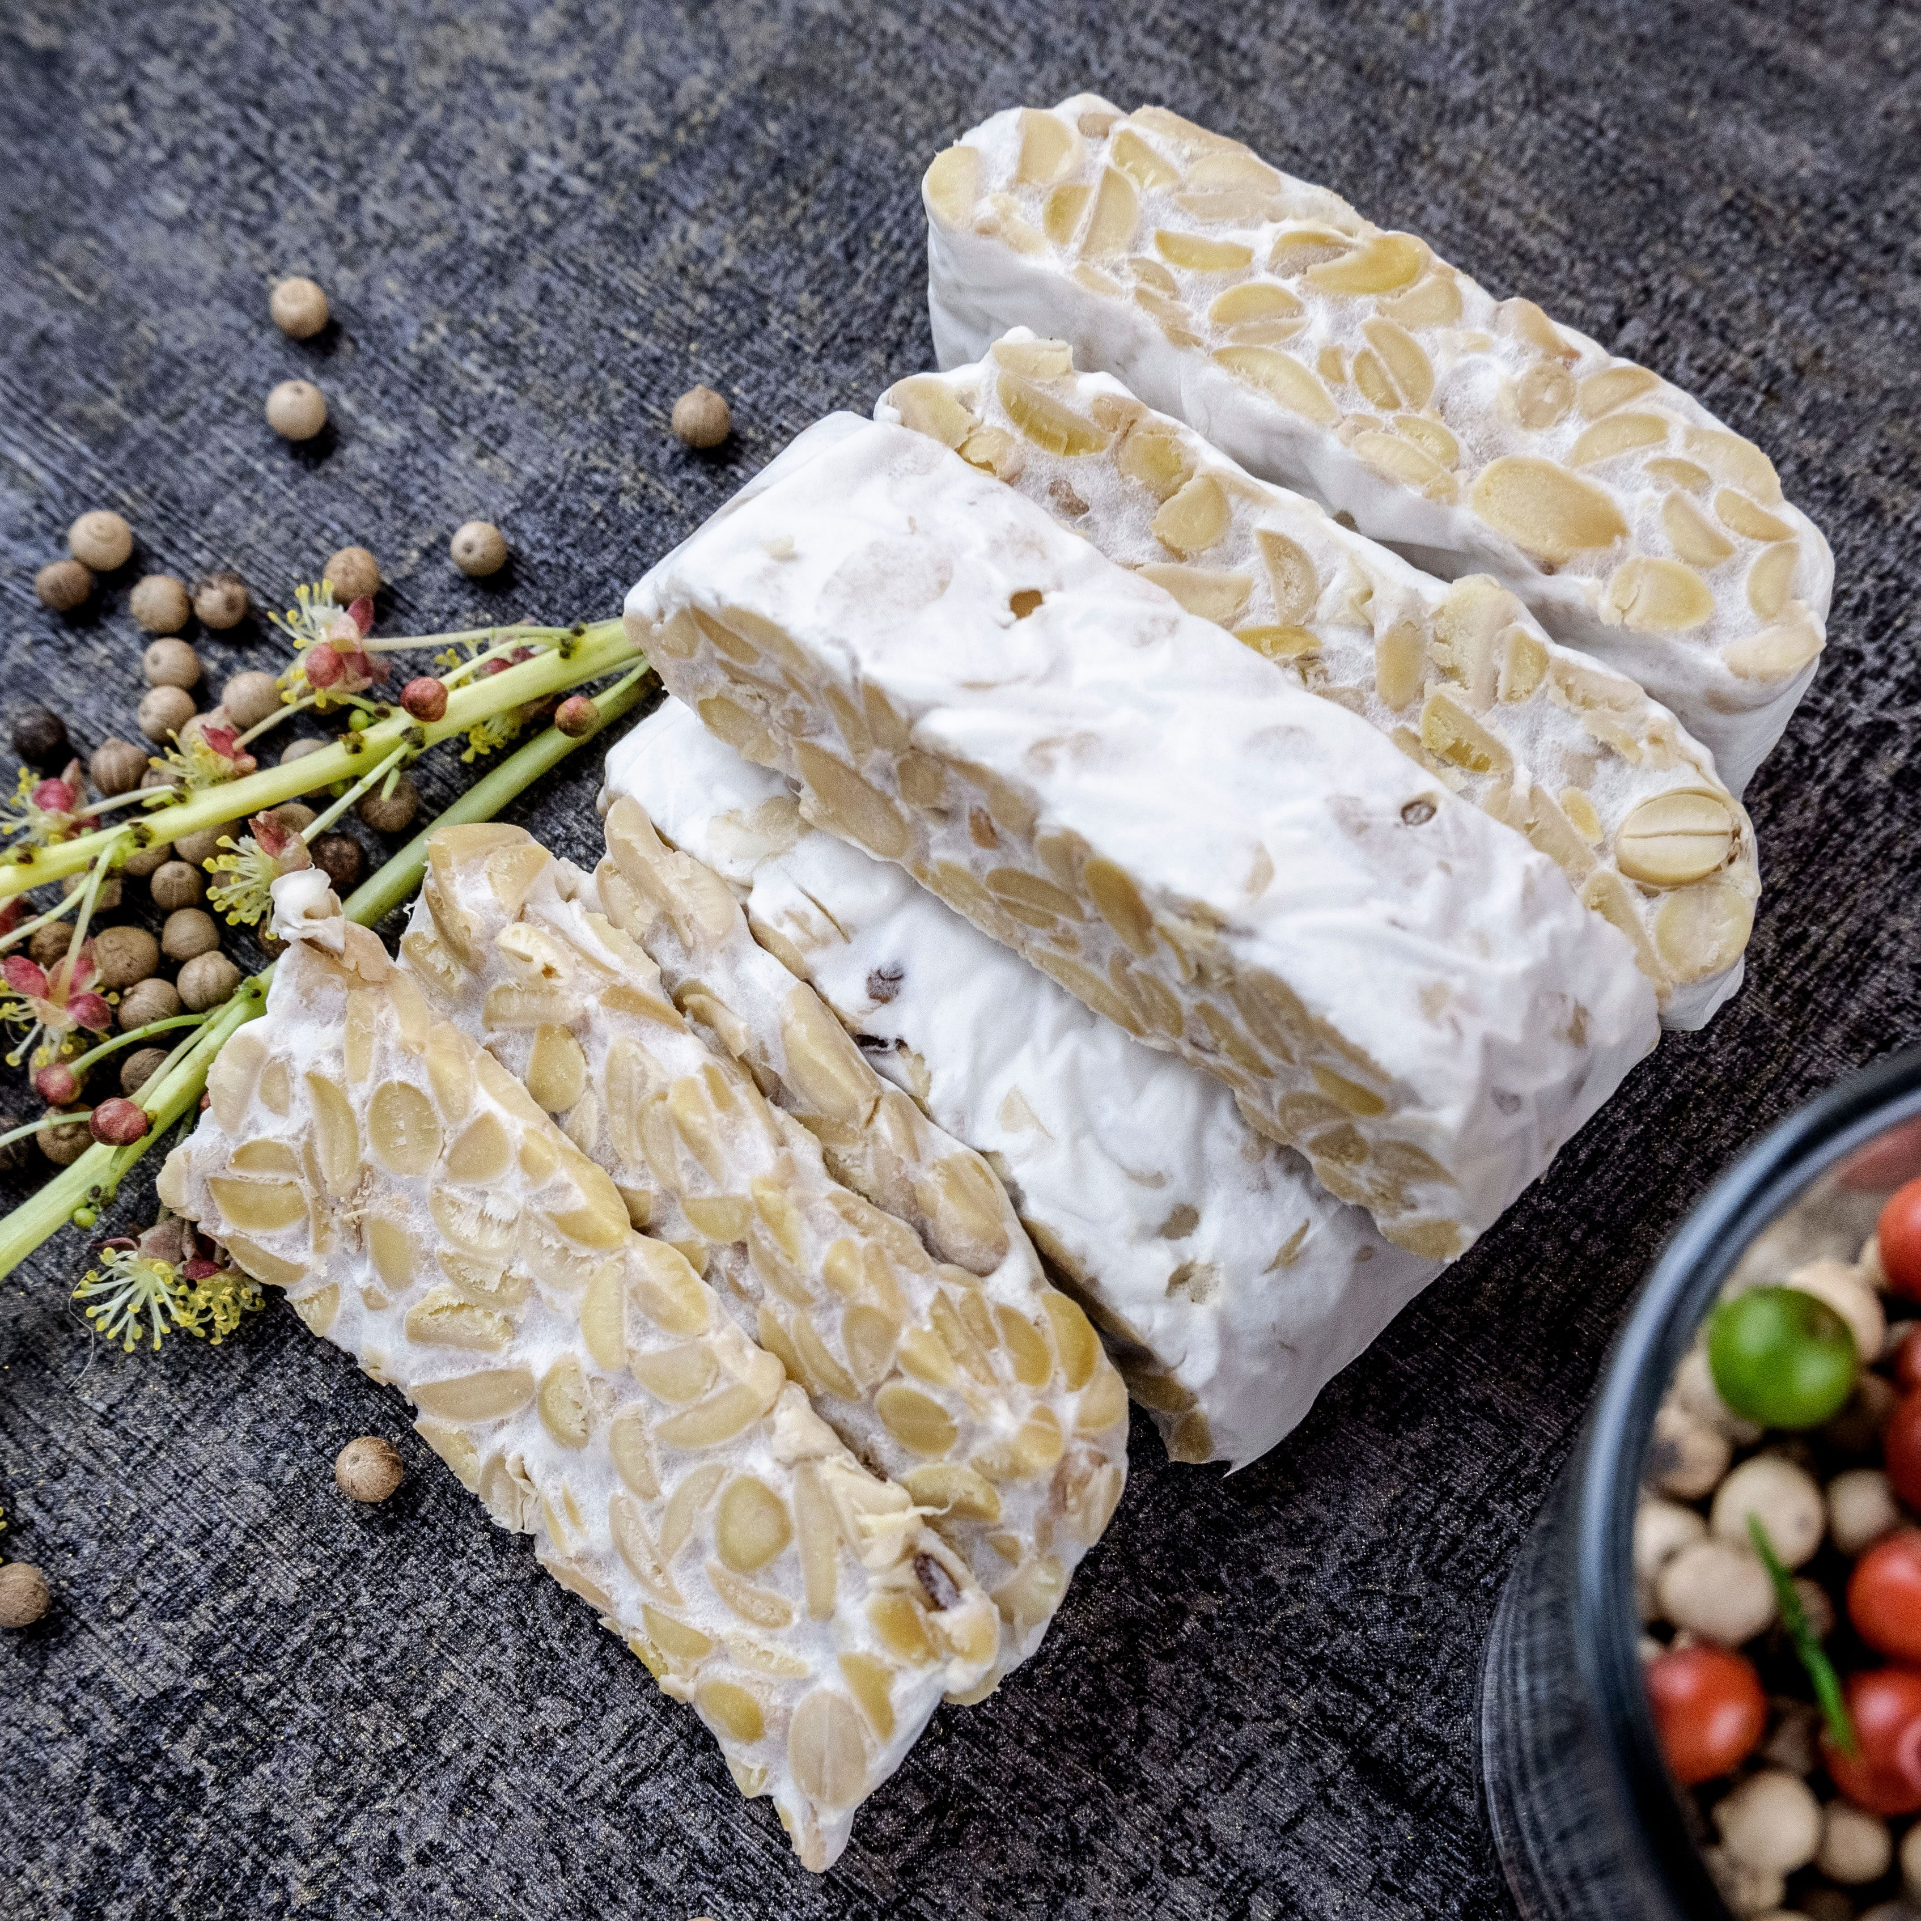

Slide 7
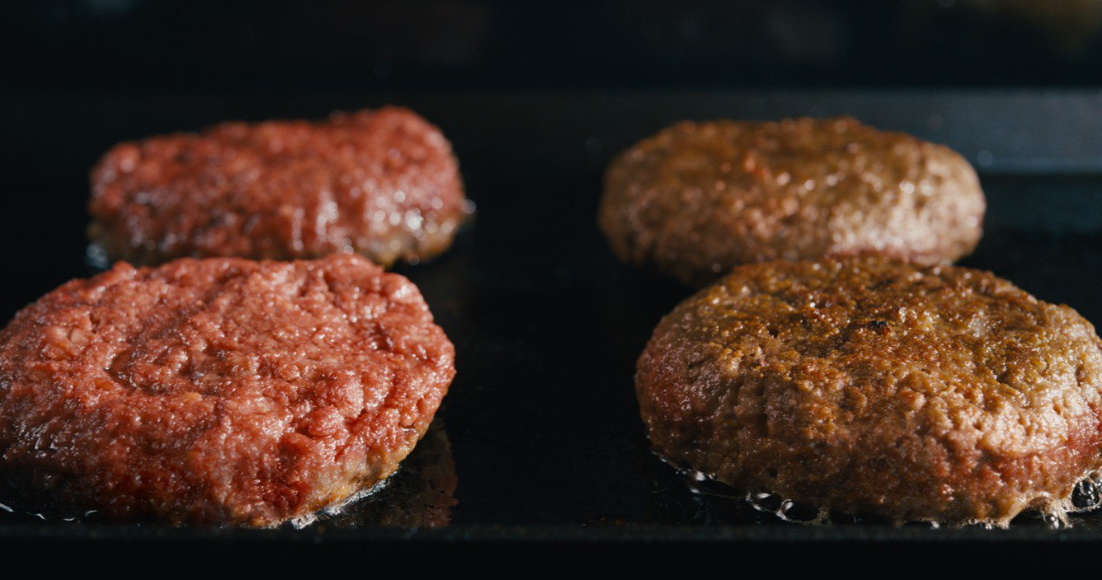
THIS IS MEAT
…RIGHT?

Slide 8


2009
Dr. Patrick O. Brown
Stanford researcher and professor of Biochemistry.
Took a sabbatical to study the world’s largest environmental problem: the use of animals to produce food.
Recruited a small team of scientists to determine:
Why does meat smells, handles, cooks
and tastes like meat?

Slide 9

In July 2011, founded

Slide 10
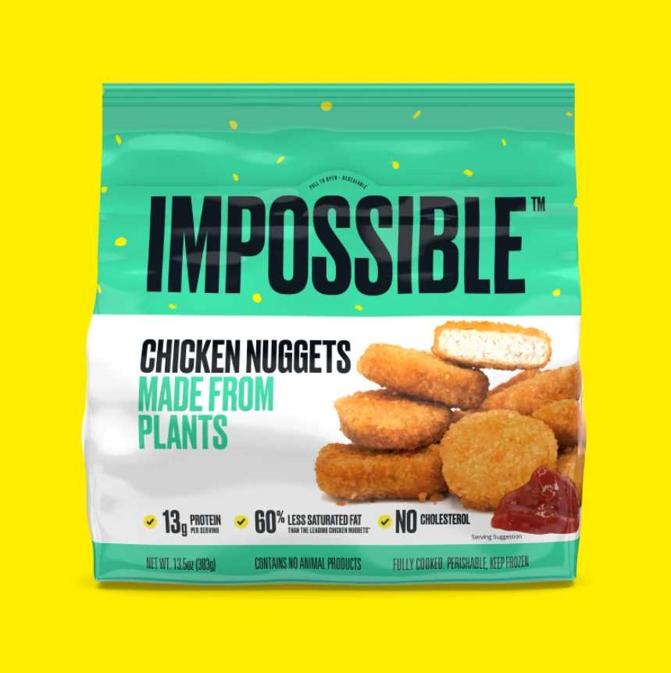
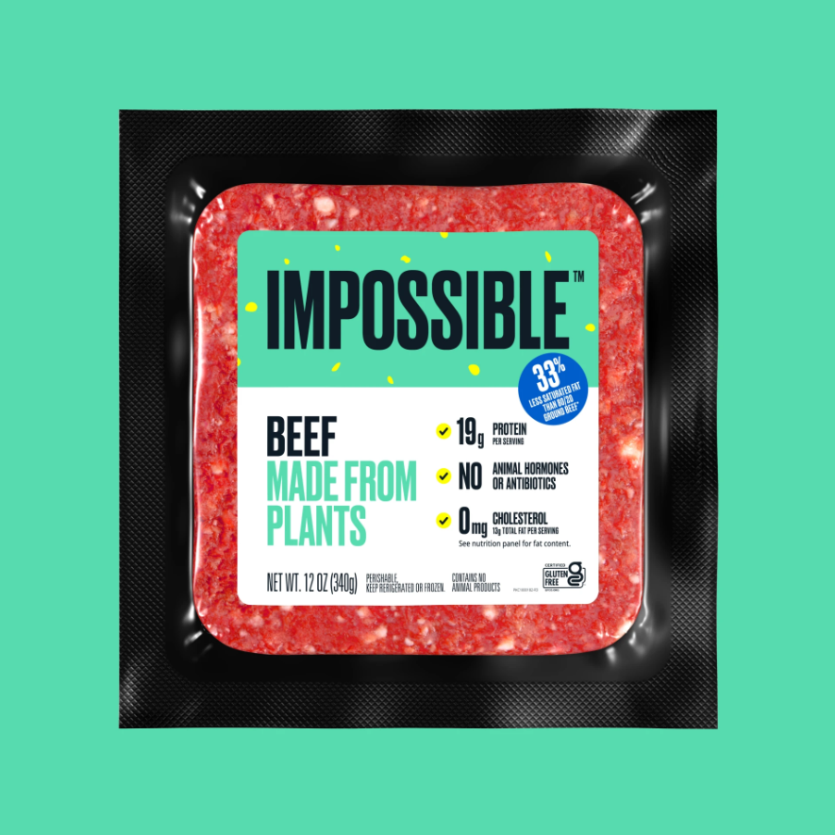
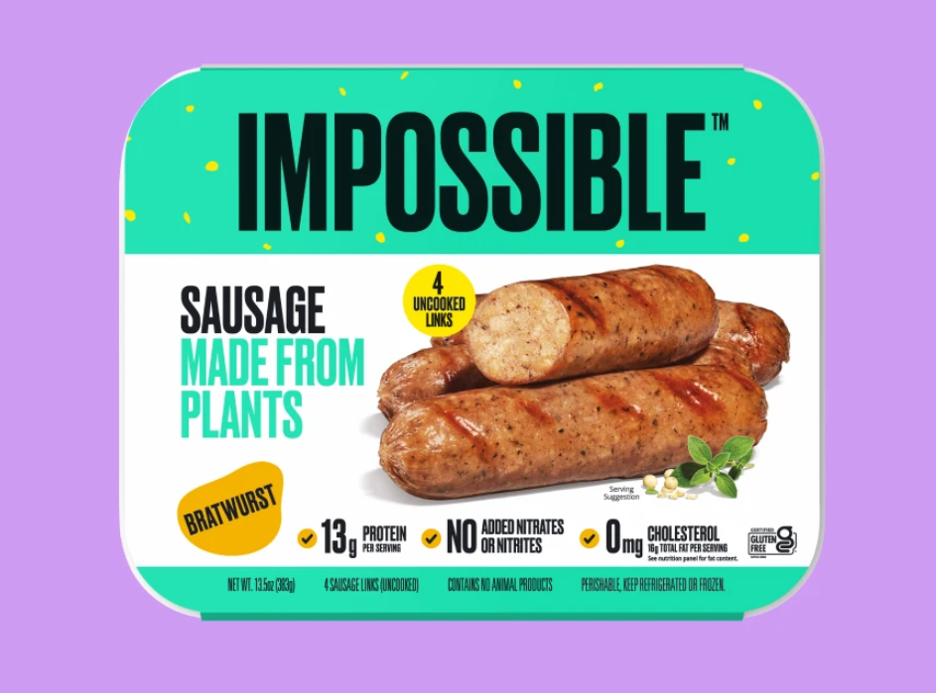
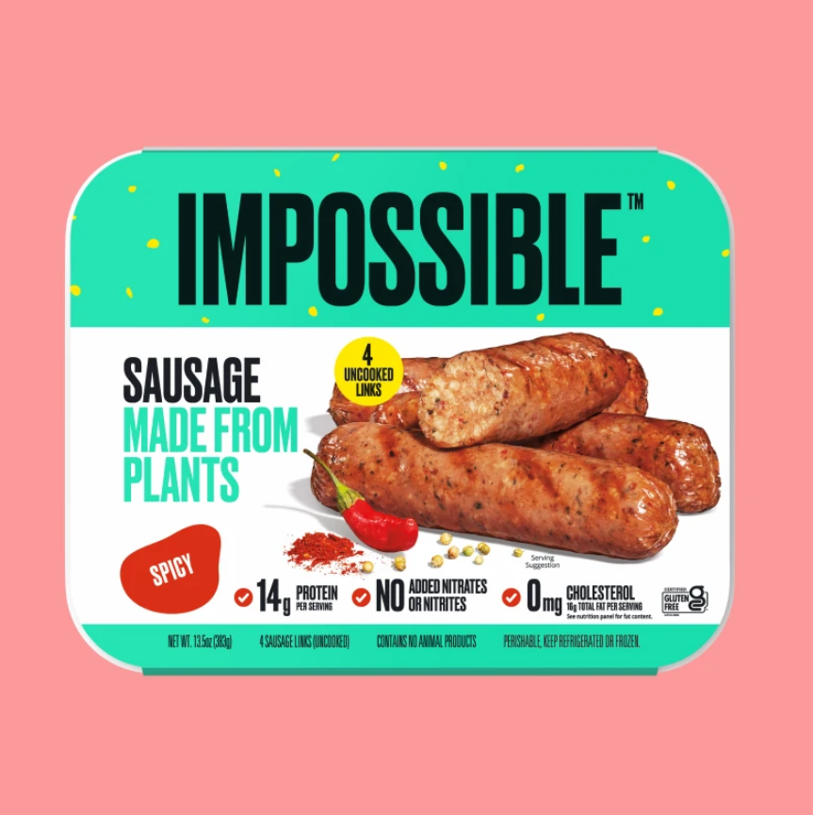

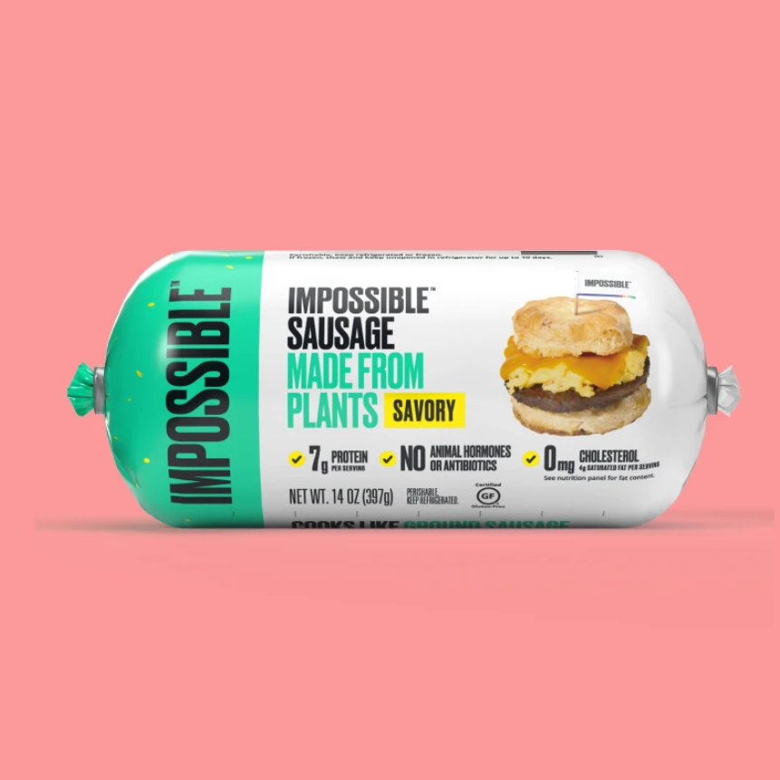
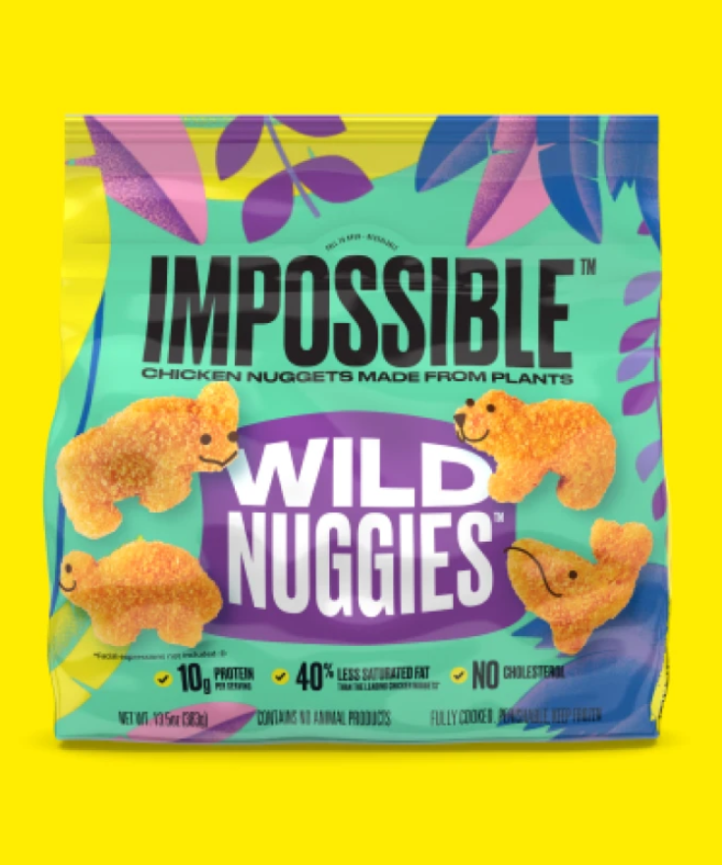
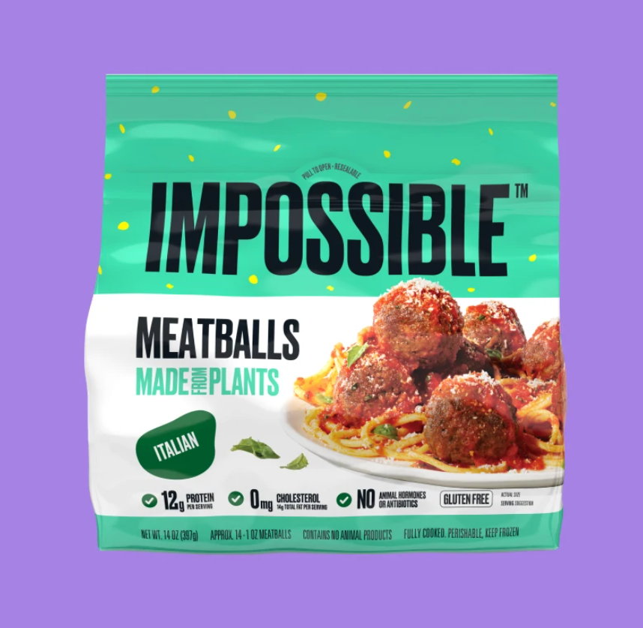
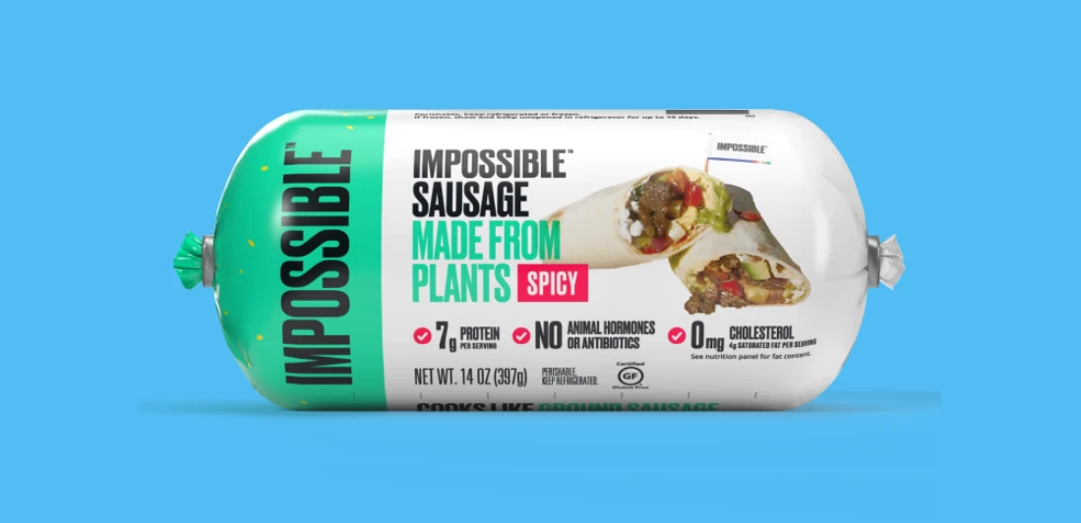
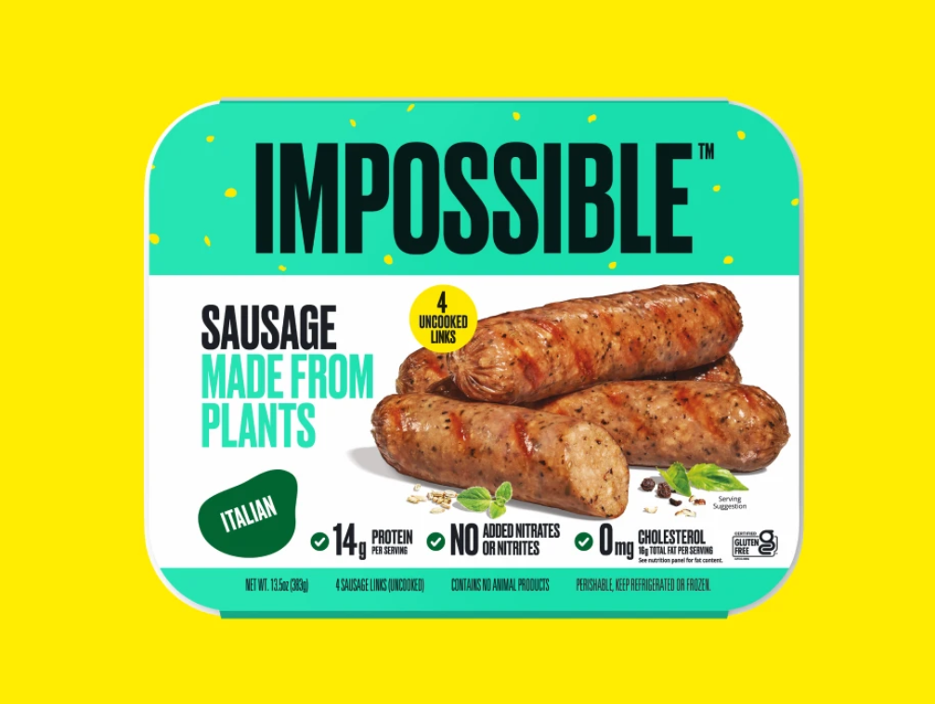
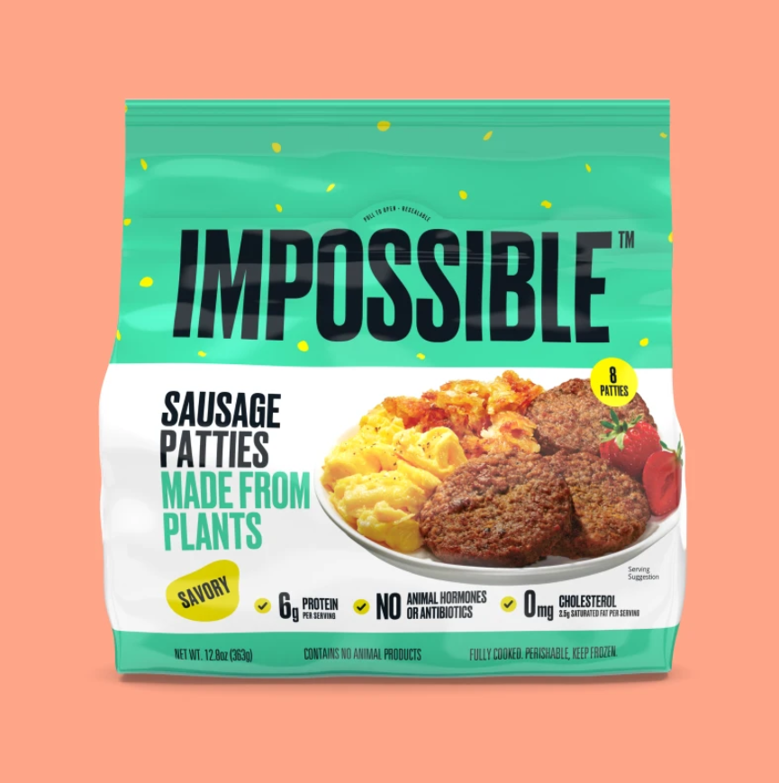
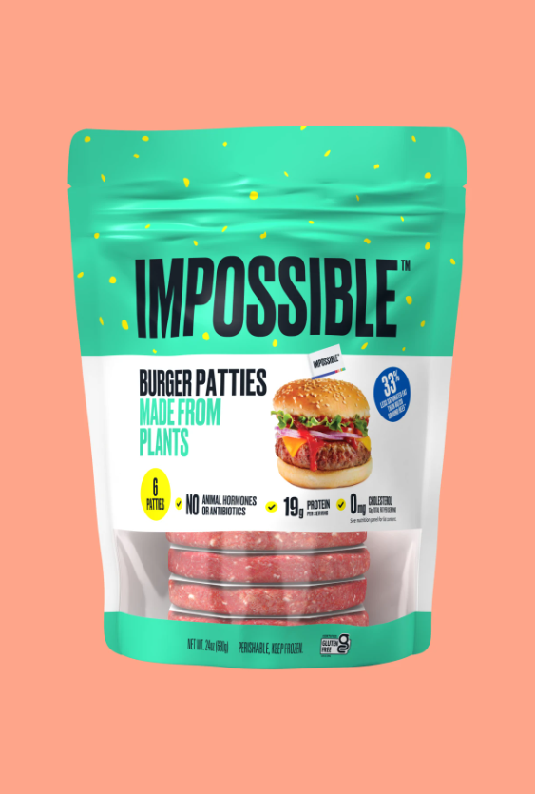
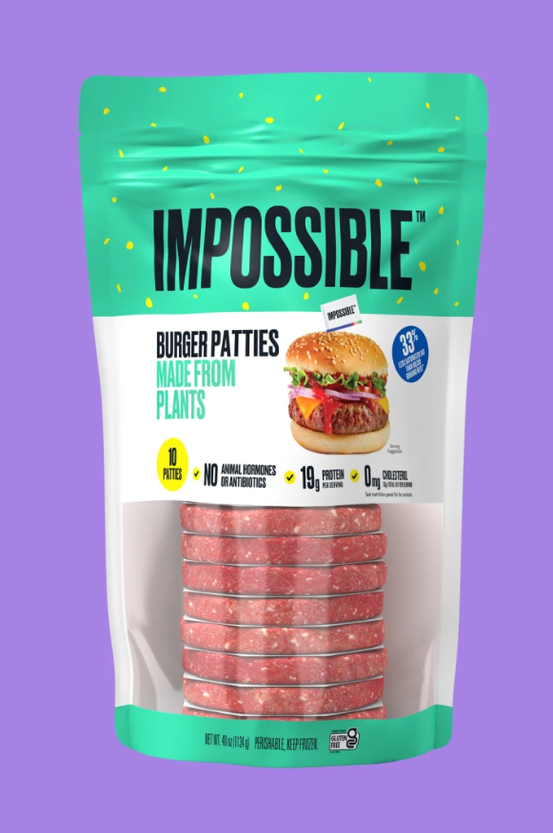
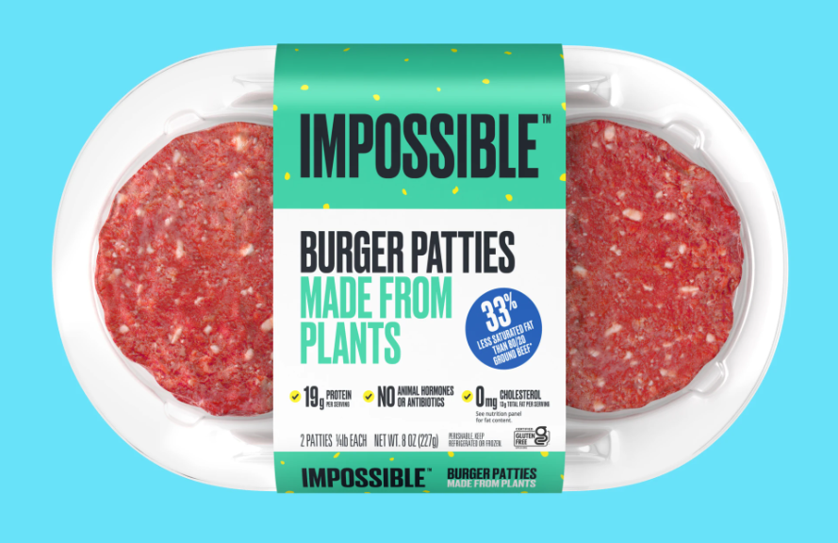
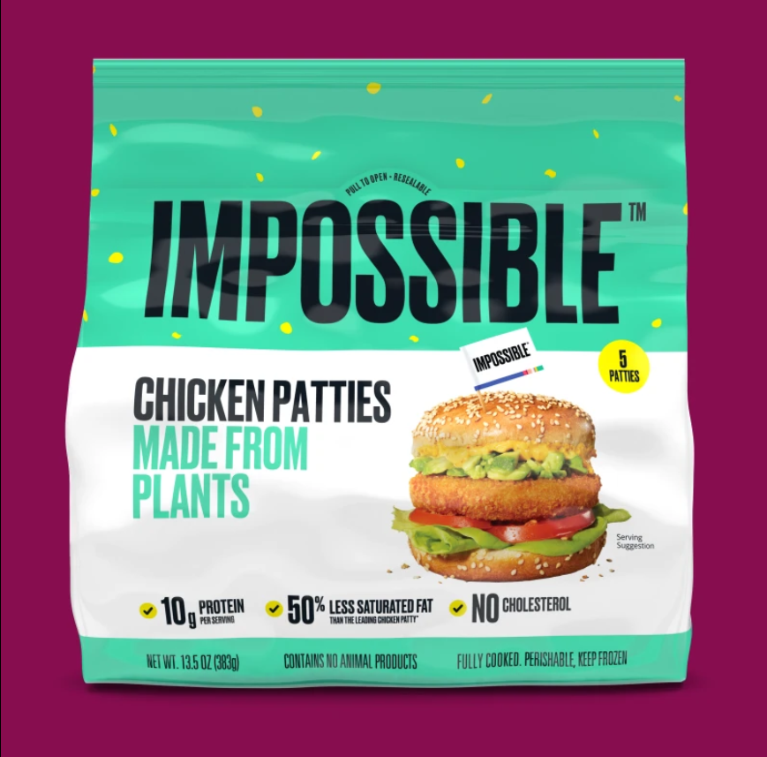
25
products

Slide 11
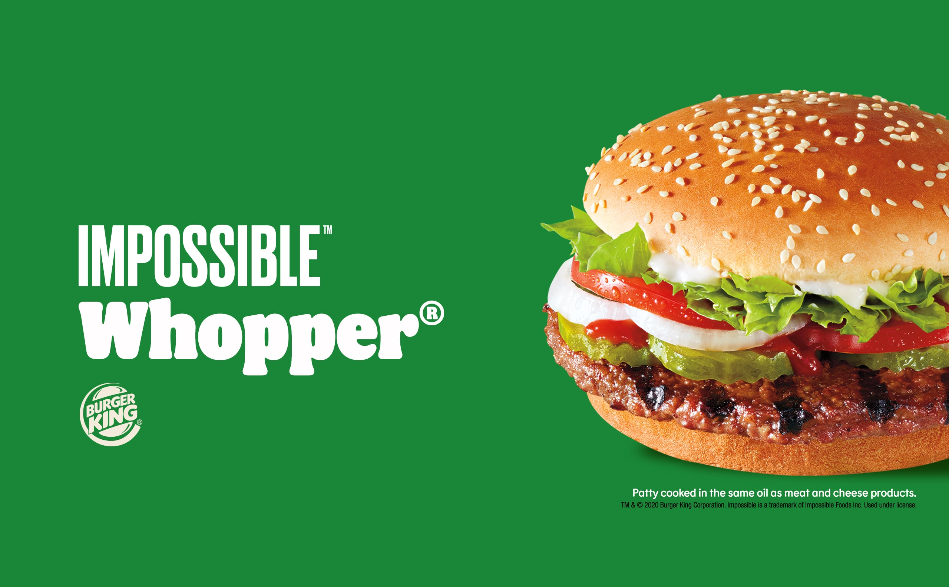
August 2019

Slide 12


$1.9 BILLION FUNDINDG
From Bill Gates, Google Ventures, Horizons Ventures, Viking Global Investors…
VALUED AT $7 BILLION
Available in over 11.000 grocery stores and 20.000 restaurants
in the USA, Canada, Asia and UK.

Slide 13
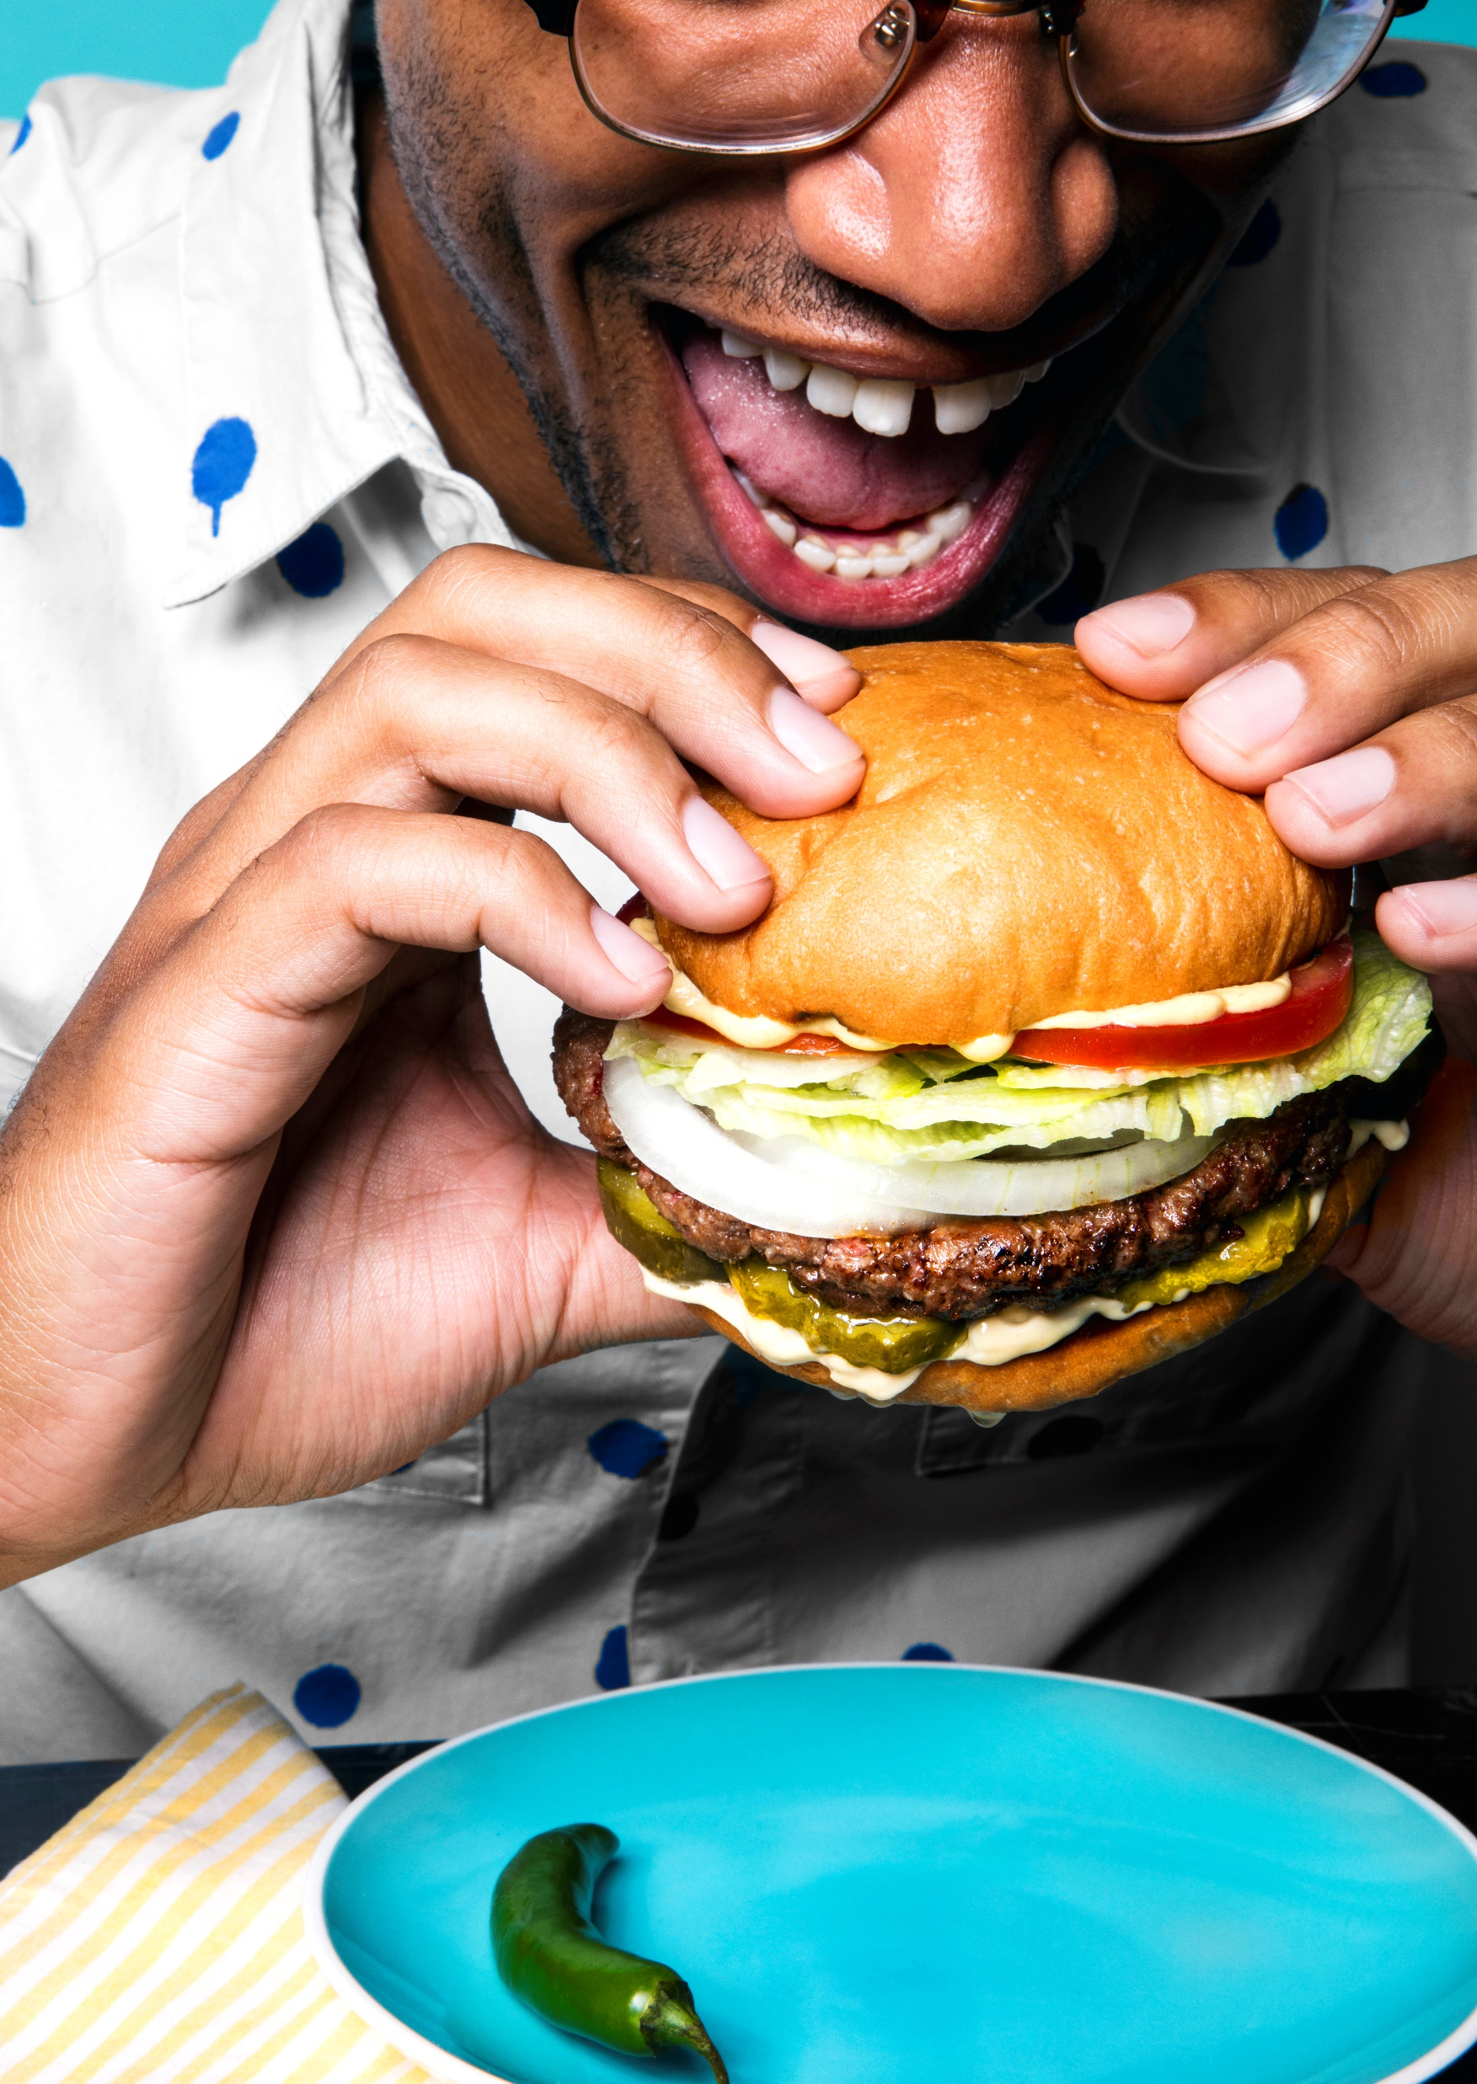
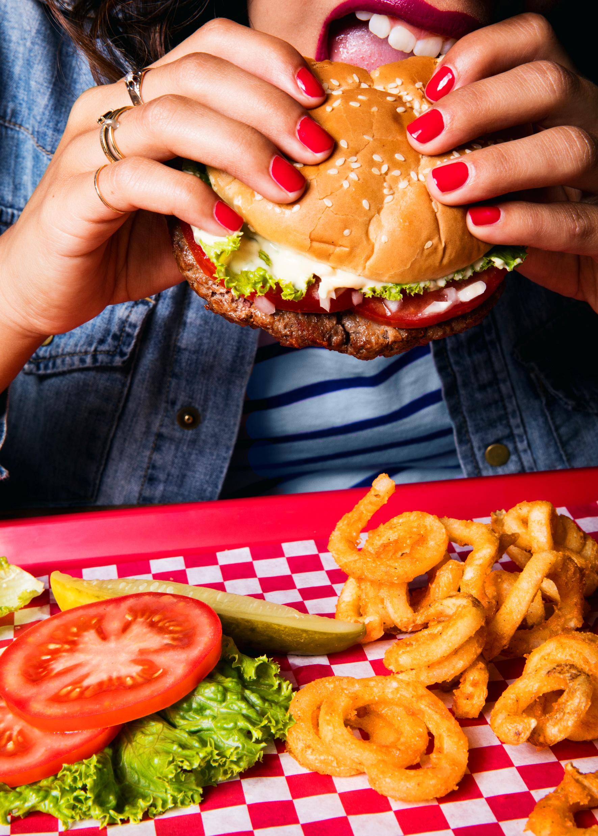
WHY
SO
SPECIAL?

Slide 14
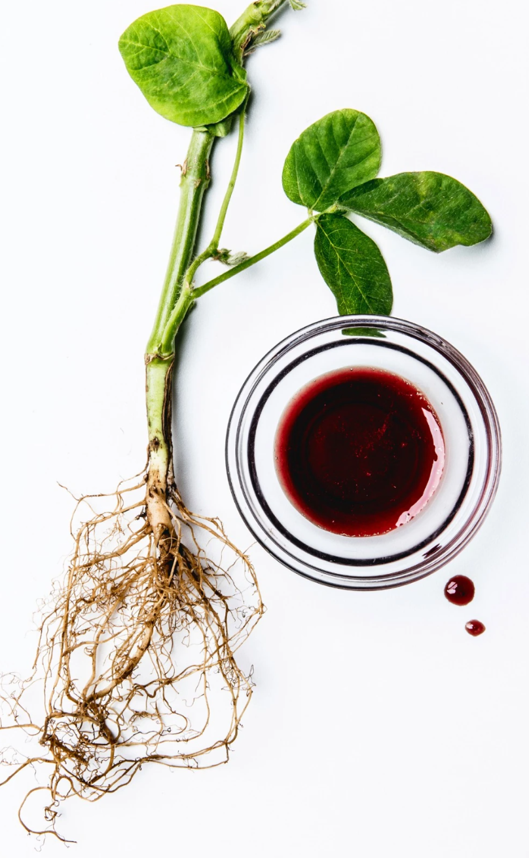
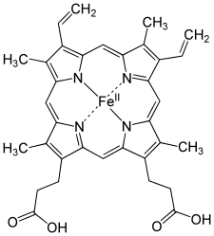
HEME
Discovered in 1892, it is a precursor to hemoglobin, which is necessary to bind oxygen in the bloodstream.
Impossible Foods was the first one to discover that Heme makes meat taste like meat.
It is found in every living being - both plants and animals.
Impossible Foods’ heme is made by putting DNA from soy plants into a genetically engineered yeast. Then the yeast is fermented.

Slide 15
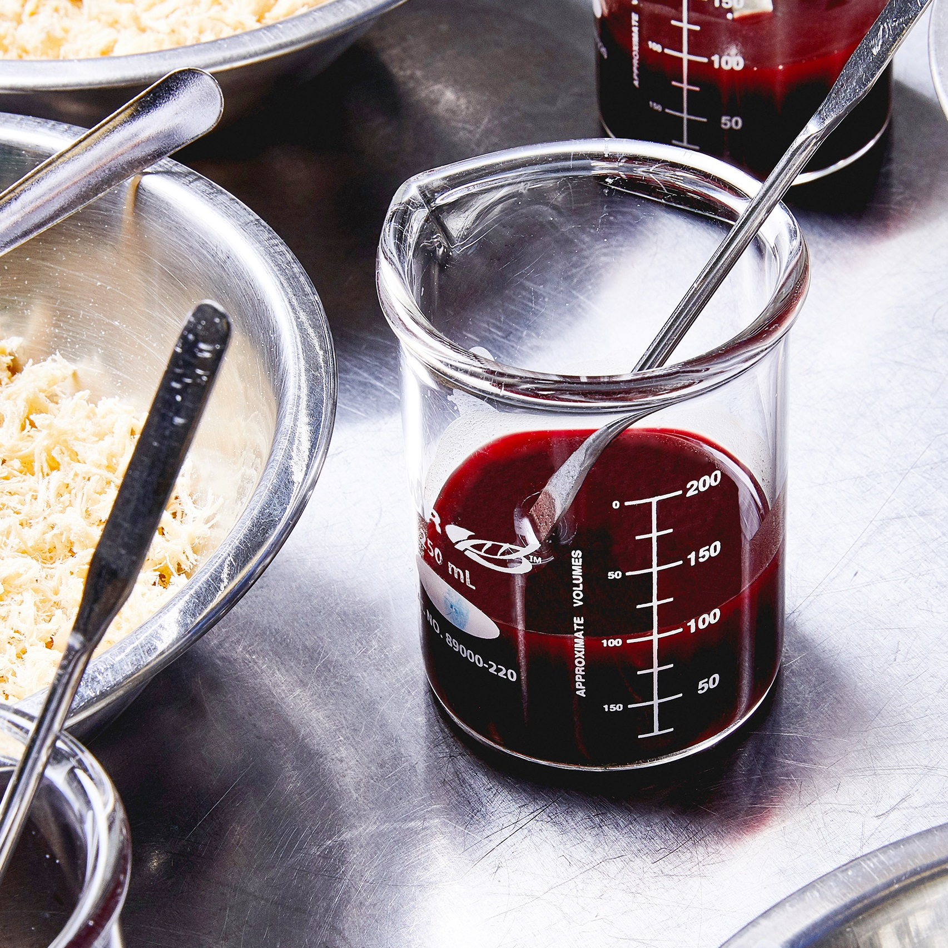

HOW TO PROTECT SUCH DISCOVERY?
PATENT: license which grants the right to exclude others from using, making or selling your invention.
To get a patent technical information about the invention must be disclosed to the public in the application.
Patents are territorial, hence not valid in every country.
They last generally 20 years from the filing date of the application.
Impossible Foods protected the ingredient and its production processes.

Slide 16
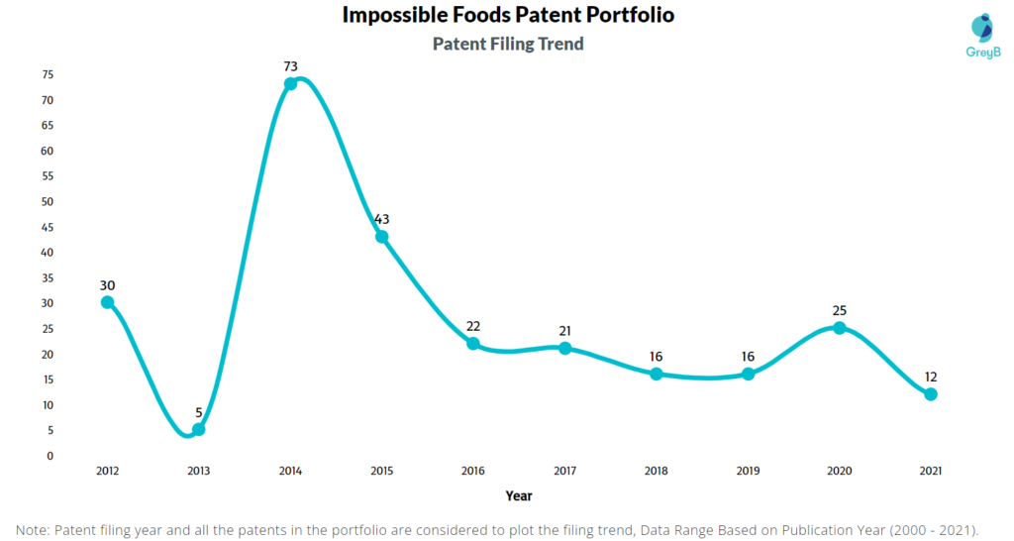
HOW MANY PATENTS EVERY YEAR?
263 patents in total globally, 103 granted

Slide 17
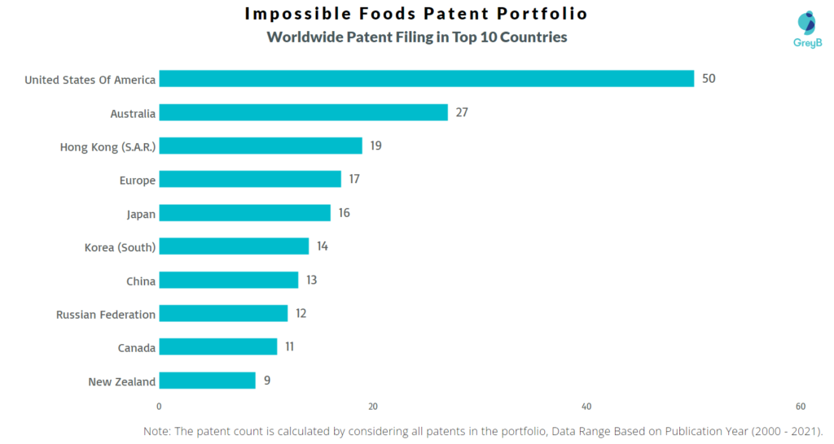
HOW MANY PATENTS IN EACH COUNTRY?

Slide 18


VS

Slide 19

Founded in 2019, in Boston
Food technology company that innovates food to make plant-based foods tastier and sustainable
In 2021 launched HEMAMITM, a yeast-derived heme protein that provides umami flavor and meaty aroma to plant-based meat alternatives
…sounds familiar?

Slide 20
12 July 2013
July 2016
23 August 2021
Impossible Foods applies for first patent about Heme in the US
Impossible Foods
launches the
Impossible Burger
HEMAMITM is registered as trademark
Impossible Foods starts applying for patents in other countries
Motif Foodworks announces the commercial launch of HEMAMITM
2014
22 June 2021

Slide 21
09 March 2022
25 July 2022
IF sues Motif alleging infringement of U.S. Patent
No. 10.863.761
IF includes 4 patents to the motion against Motif
Motif fills petition against IF claiming its patent is obvious
IF includes 2 more patents to the motion against Motif
20 April 2022
06 September 2022

Slide 22
26 October 2022
18 December 2022
Motif’s petition against IF is rejected by PTAB
European Patent Office revokes patent to IF
Motif fills 4 more petitions against IF’s patents
07 December 2022

Slide 23



OBSERVATIONS
Are
patents good for innovation?
Patents are not universal
Who
is
right?

Slide 24
SOURCES
Slide n. 3: https://ourworldindata.org/co2-and-other-greenhouse-gas-emissions
Slide n. 4: https://ourworldindata.org/emissions-by-sector
Slide n. 5: https://ourworldindata.org/meat-production
Slide n.6: https://www.globaldata.com/data-insights/consumer/growing-demand-for-meat-alternatives/
Slide n. 8, 9: https://impossiblefoods.com/company/overview
Slide n. 10: https://impossiblefoods.com/products
Slide n. 11: https://www.cnbc.com/2019/07/31/burger-kings-plant-based-impossible-whopper-is-launching-nationwide-this-month.html
Slide n. 12: https://www.crunchbase.com/organization/impossible-foods
Slide n. 14: https://impossiblefoods.com/heme
Slide n. 15: https://patents.justia.com/assignee/impossible-foods-inc
Slide n. 16, 17: https://insights.greyb.com/impossible-foods-patents/
Slide n. 19: https://madewithmotif.com/
Slide n. 20: https://patents.google.com/patent/EP3345484B1/en?oq=US9826772B2, https://alter.com/trademarks/hemami-90897535, https://madewithmotif.com/2021/12/08/motif-foodworks-announces-the-commercial-launch-of-hemami-food-tech-earns-generally-recognized-as-safe-gras-status-from-fda/
Slide n. 21, 22: https://portal.unifiedpatents.com/ptab/caselist?filings.full_text=Motif+Foodworks&sort=-filing_date, https://worldwide.espacenet.com/patent/search/family/053675762/publication/EP2943072B1?q=EP2943072B1, https://www.fooddive.com/news/impossible-foods-sues-motif-foodworks-over-its-plant-based-heme-product/620147/

Slide 25
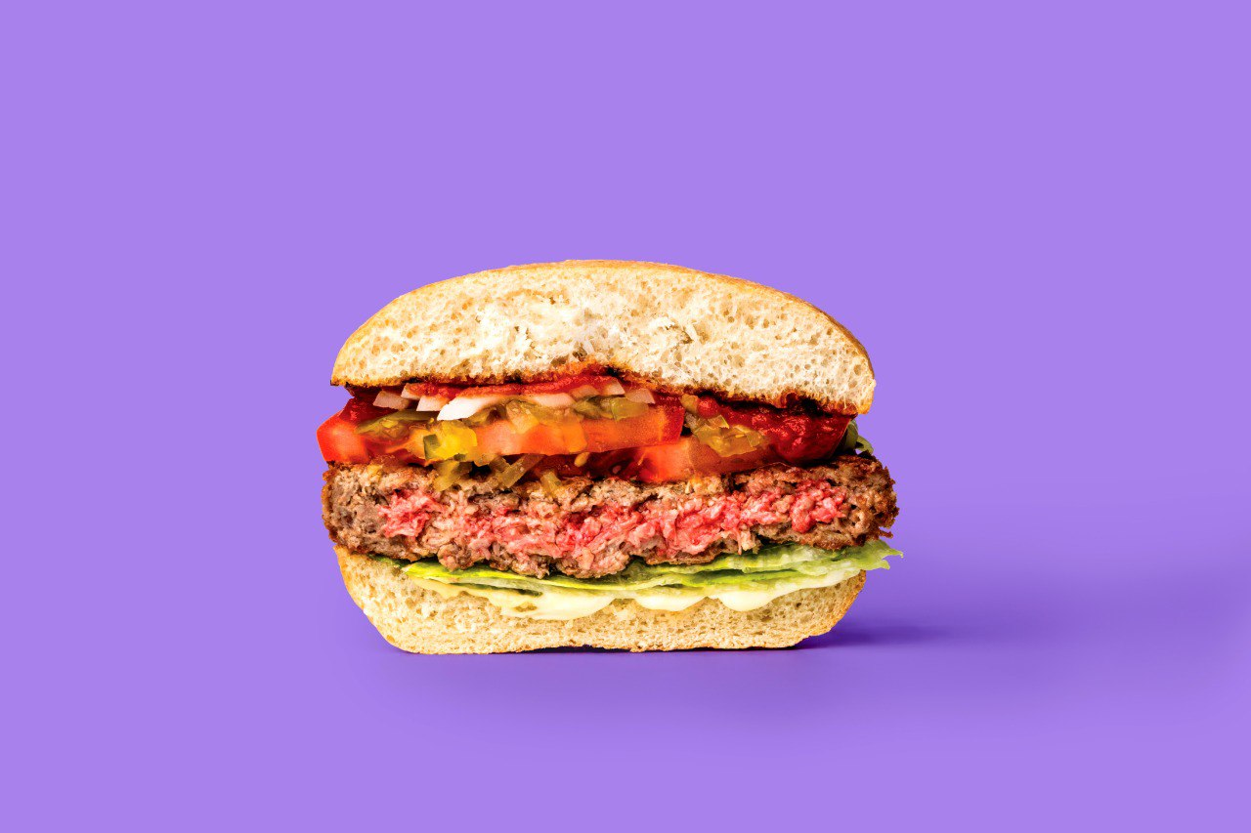
THANK YOU
FOR YOUR
ATTENTION

